Slide 1
fyp4
File created on: 31/1/2021 5:17:21 PM

Slide 2
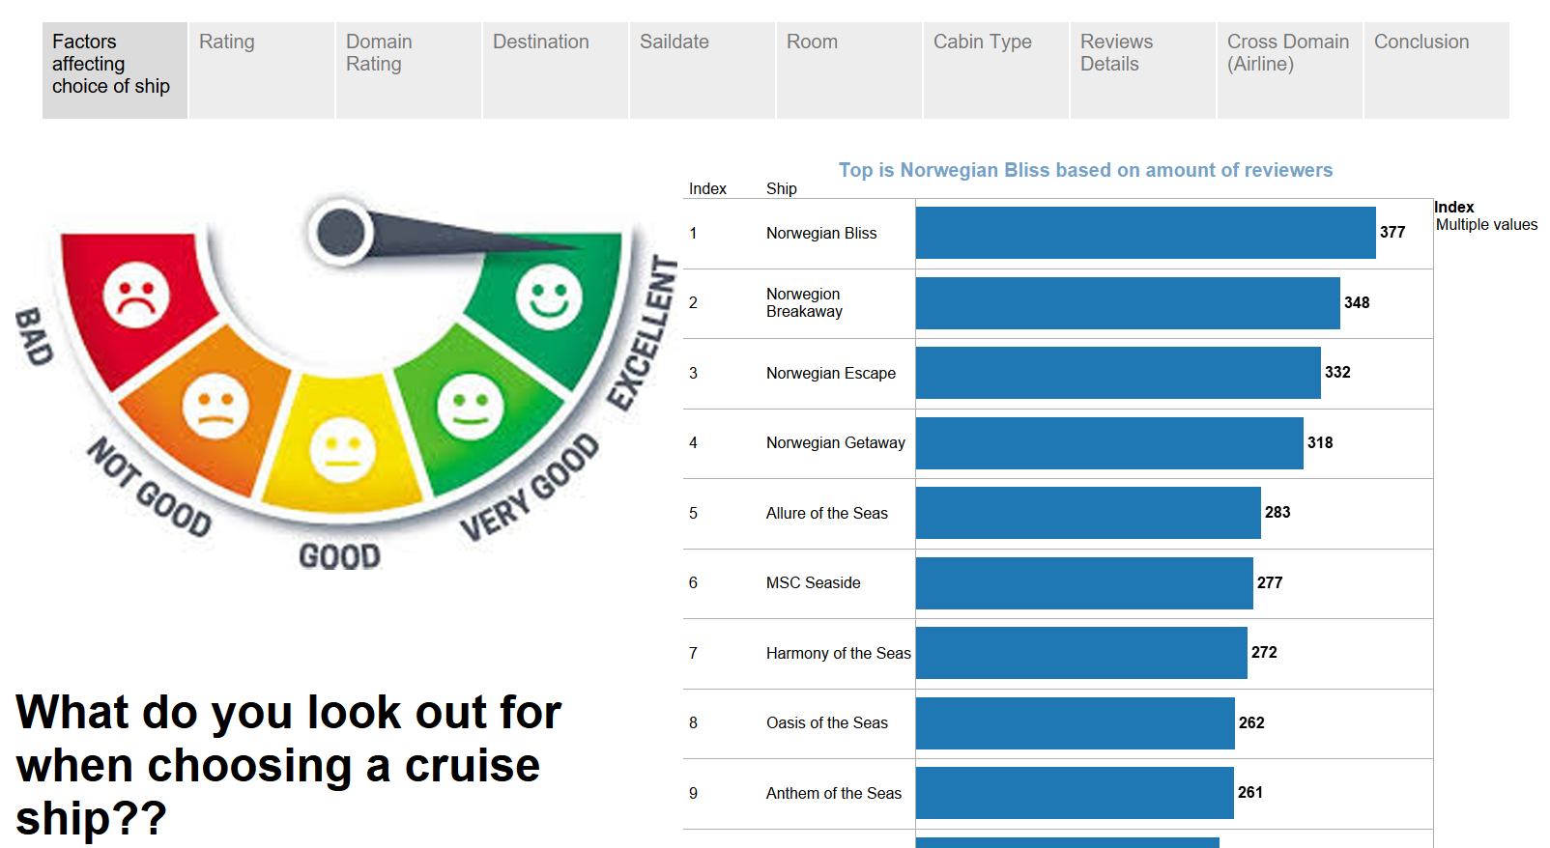

Slide 3
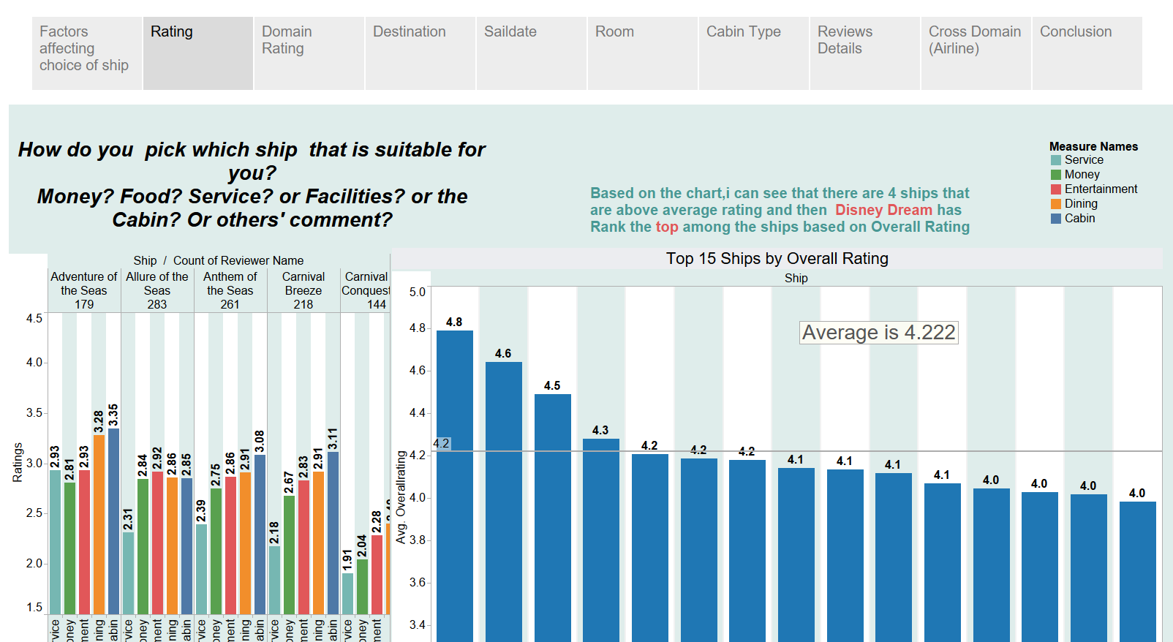
Having to click on any ships and then it would show the domain ratings

Slide 4
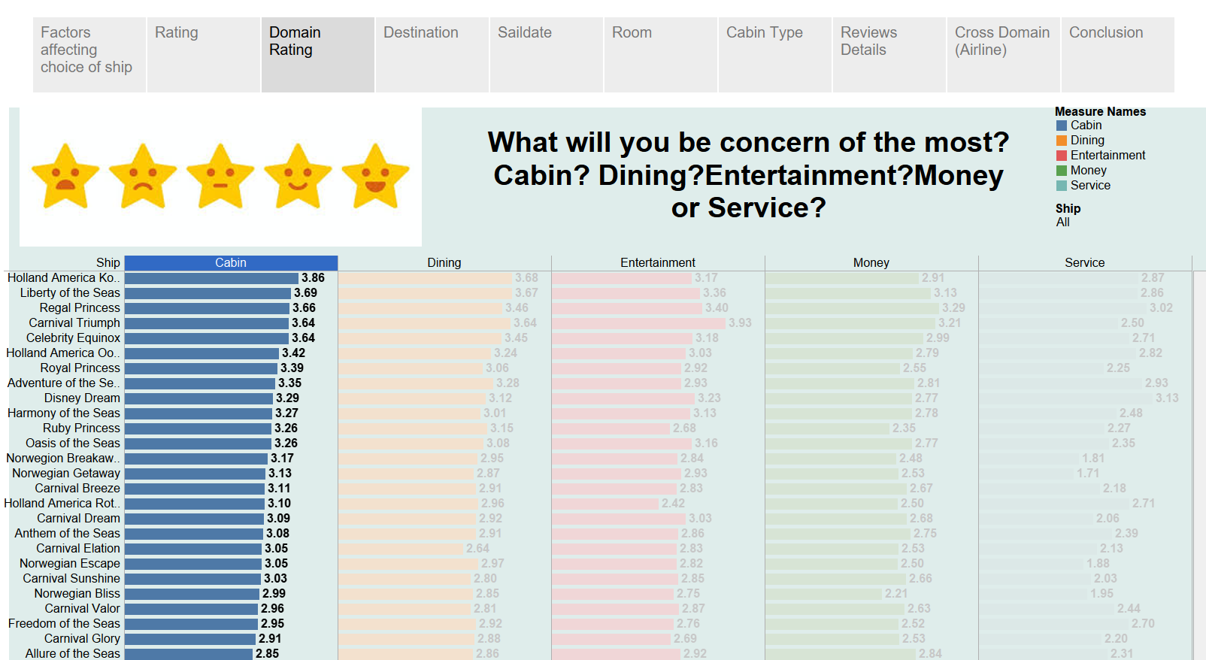
Can use to compare ships that you wish to
Clicking on any domains and then sorting them to find highest or lowest

Slide 5
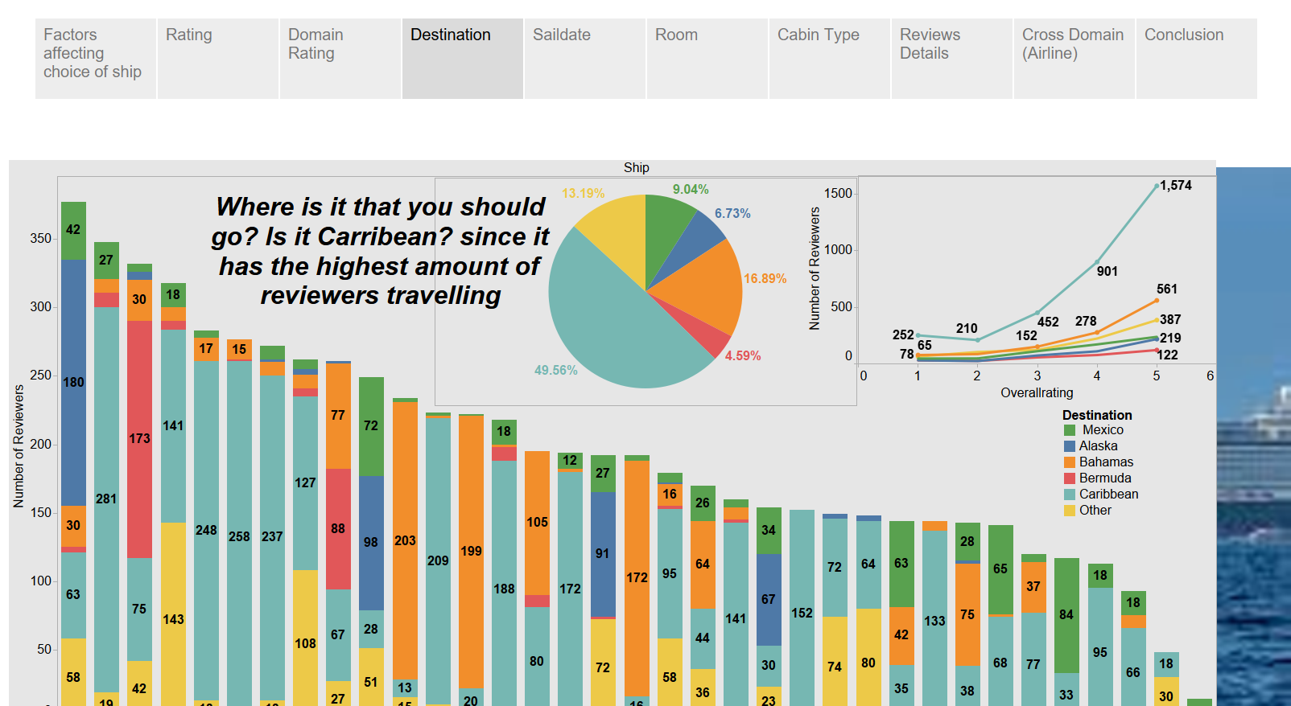
Click on the destination and see which ship goes the most
To see the rating for the place
Click on ships to see where it goes

Slide 6
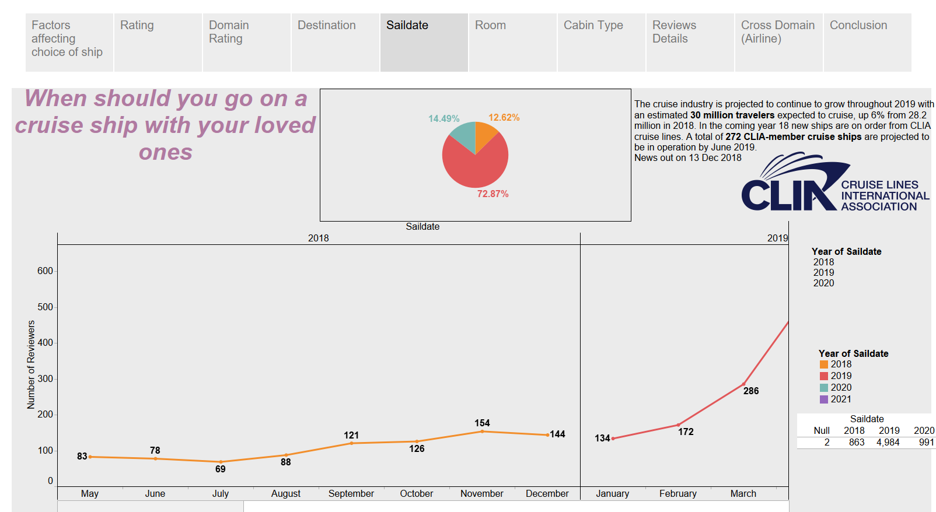
To see the year

Slide 7
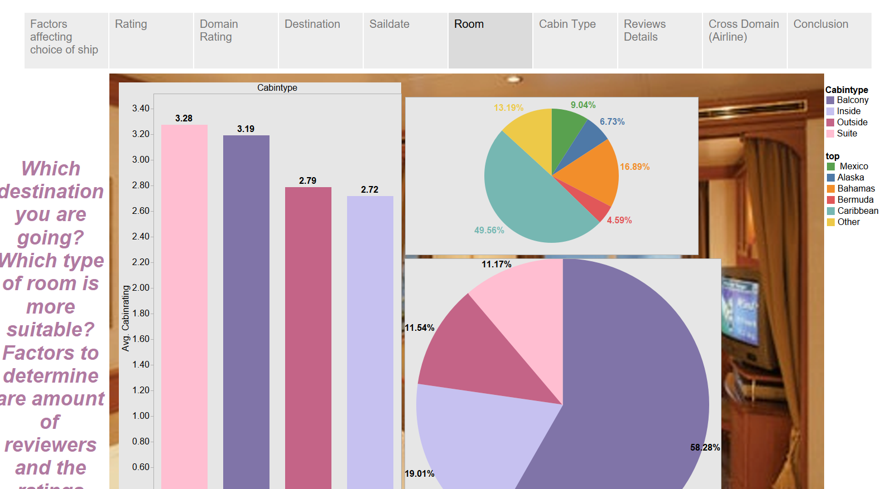
Click to see rating for cabin type for different destination

Slide 8
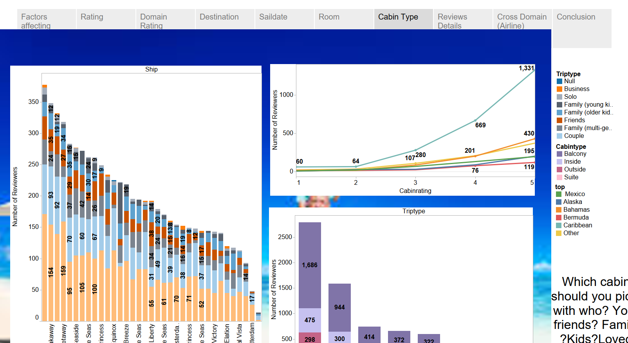
Click to see the trip type
Click to see the cabin type

Slide 9
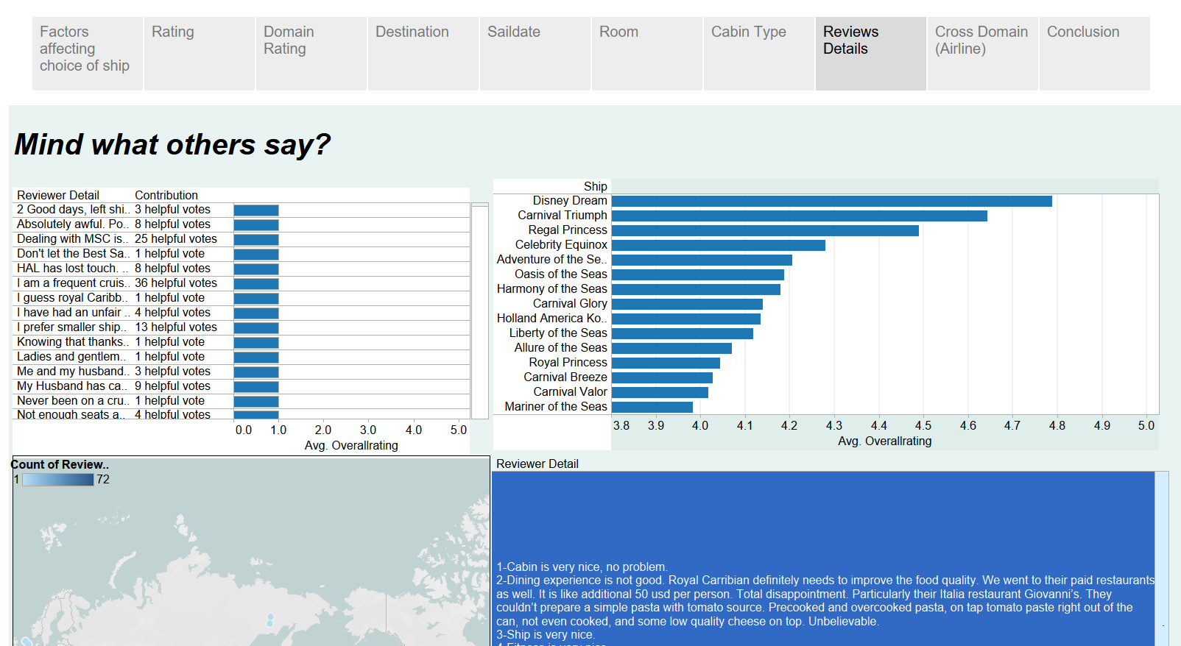
To see the whole review detail
Getting review details for the ship selected

Slide 10
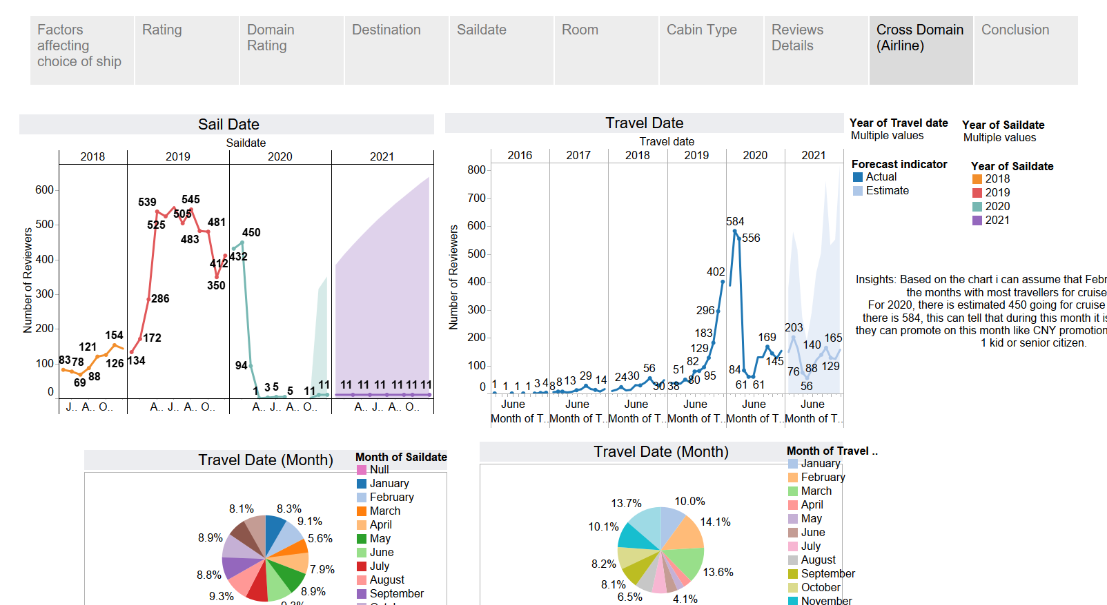

Slide 11


